Slide 1
Anime Recommendation System: A Personalized Approach
Group : 2
Section BDS-5A
Sohaib Ahmed 21L-5635
Hamza Rao 21L-5636
Hassan Khalid 21L-5692

Slide 2
Introduction to Anime Recommendation System
Problem Statement:
The challenge: How to effectively recommend anime titles tailored to individual tastes from a vast and diverse library.
Overview: This project utilizes advanced data analysis and machine learning techniques to offer personalized anime recommendations. Leveraging user ratings and detailed anime metadata, the system employs TensorFlow deep learning capabilities for pattern recognition in user-anime interactions.
Libraries Used: pandas, numpy, scikit-learn, TensorFlow, matplotlib, seaborn, wordcloud, etc.
Aim: To build an anime recommendation system based on ‘Anime’ dataset. We wish to integrate the aspects of personalization of user with the overall features of anime such as genre, popularity rating and score etc.
Notes:
Implemented popularity model, content based model, collaborative filtering model and latent factor based model and combining the above to form a hybrid model.
Hyperparameter tuning, testing accuracy and evaluation of recommendations of each model

Slide 3
Data Overview
Anime Information:
This dataset provides an extensive collection of 24 attributes for 24,905 anime entries, detailing titles, genres, ratings, and popularity, along with production and content information like studio, source, and synopsis.
User Profiles:
With data of 15 attributes having 731,290 user profiles, this dataset includes demographic information, platform engagement metrics such as mean scores and total episodes watched, offering insights into user preferences and viewing habits.
User Ratings:
A concise dataset containing 6 attributes of 24,325,190 user ratings, which pairs user and anime IDs with the ratings given, enabling analysis of viewer preferences and satisfaction across different anime titles.
Notes:
The primary dataset used for this project is the movielens review dataset. consisting of 27,753,444 reviews over 58,098 different movies by 283,228 users.

Slide 4
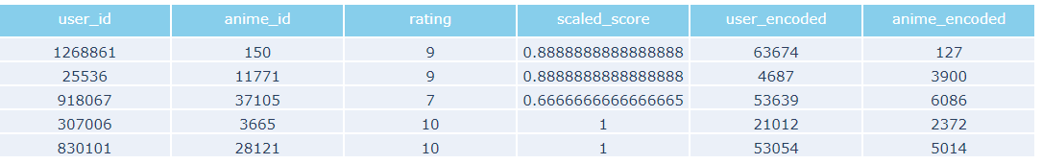
Data Preprocessing:
Data Preparation and Cleaning
Identifying and Removing Duplicate Records
First, duplicates in the dataset were identified using df.duplicated(). This step ensures the uniqueness of each record, a crucial factor for maintaining data integrity and accuracy.
Standardization of Score Metrics via Normalization
Score metrics were standardized through normalization, specifically scaling the scores to a range of 0 to 1. This process, achieved by applying MinMaxScaler.

Slide 5
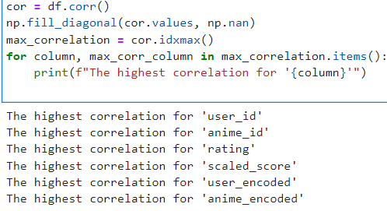
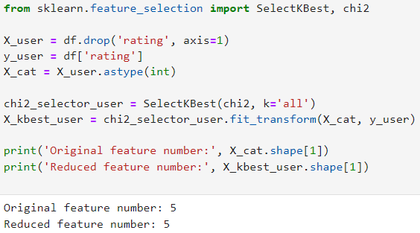
Feature Selection:
Feature Selection Using Chi-Squared Test
Feature selection was carried out using the SelectKBest function with the chi2 method. This process identifies and retains features that have the most significant relationship with the target variable.
Identifying Maximum Correlations Between Features
Correlation analysis was performed using the corr method on the df. By identifying the highest correlations, it aligned closely with the underlying structure of the dataset.

Slide 6
Model Training Preparation:
Streamlining Data for Optimal Learning
Data Shuffling and Splitting
The dataset underwent shuffling (shuffle) and was split into features (X) and target (y) variables. This process randomizes the data order and sets the stage for unbiased model training and validation.
Train-Test Division
A train-test split was implemented using train_test_split, segregating the data into training and test sets. This division is essential for evaluating the model's performance on unseen data, ensuring its generalizability.
Output: Number of samples in the training set: 90000
Number of samples in the test set: 10000

Slide 7
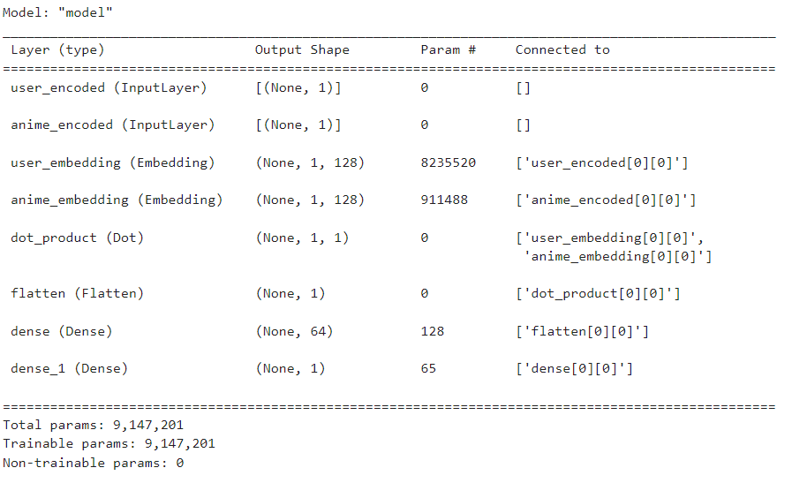
Model Summary

Slide 8
Deep Learning for Recommender Systems
Title: Crafting a Collaborative Filtering Model
User and Anime Embeddings
The model uses embedding layers to convert user and anime IDs into dense vectors, capturing underlying preferences and features. This method is key for understanding complex user-anime interactions.
Dot Product and Dense Layers
A dot product layer calculates the similarity between user and anime embeddings, essential for collaborative filtering. Followed by a dense layer with 'relu' activation, the model learns to predict user preferences more accurately.
Model Compilation
Compiled with 'binary_crossentropy' and the Adam optimizer, the model is fine-tuned for binary outcomes, such as predicting a user's like or dislike. Metrics like MAE and MSE assess its prediction accuracy.

Slide 9
Model Training and Optimization
Advanced Training Techniques for the Recommender System
Learning Rate Schedule
A dynamic learning rate schedule was implemented to fine-tune model training. It starts with a small initial learning rate (start_lr), ramps up to a maximum learning rate (max_lr) over a few epochs, sustains this rate, and then gradually decreases it. This strategy adapts the learning rate to optimize model convergence.
Training Batch Size and Epochs
The model was trained with a batch size of 10,000 and for a total of 60 epochs. A larger batch size helps in faster training, while the number of epochs determines the overall training duration.
Callbacks for Model Optimization
Several callbacks were employed to enhance model training:
LearningRateScheduler: Adjusts the learning rate during training according to a defined function.
EarlyStopping: Prevents overfitting by monitoring validation loss and stopping training when no improvement is observed for a specified number of epochs.
Callbacks Application
These callbacks are applied during model training to ensure that the model converges efficiently while avoiding overfitting. The saved best weights are loaded for the final model.

Slide 10
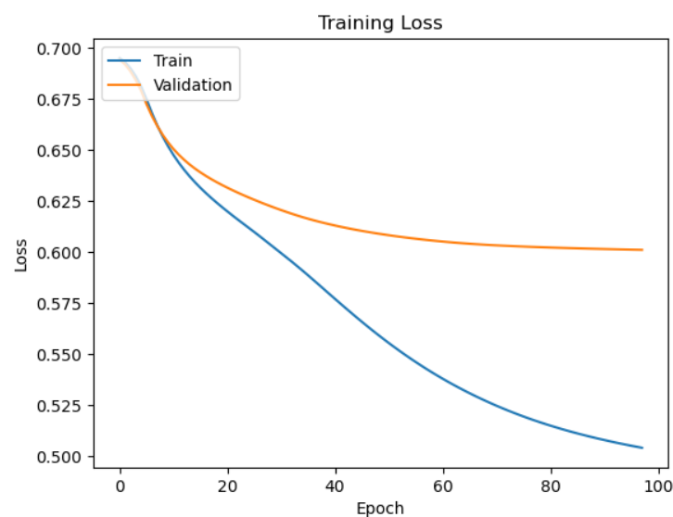

Slide 11
Models
Popularity based model
Content based model
Collaborative Filtering

Slide 12
Fine-Tuning Recommendations for Enhanced User Experience
Elevating Anime Recommendations with Deep Learning
Introduction to the Recommendation Process
Within our collaborative filtering model, we embarked on a journey to enhance anime recommendations, aiming for precision and relevance.
Embeddings Extraction for User Insights
The journey began with the extraction and normalization of embeddings from our deep learning model. These embeddings represented users and anime titles, providing invaluable insights into user preferences and anime characteristics.
Implementing the Popularity Threshold
An integral aspect of our approach was the introduction of a popularity threshold. This threshold, set at a minimum number of user ratings (popularity_threshold), ensured that our recommendations encompassed only anime titles with a sufficient level of popularity and user engagement.
To further enhance recommendation precision, we harnessed deep learning-based embeddings (anime_weights and user_weights), which encapsulated user preferences and anime characteristics.

Slide 13
Slide 8: Personalized Anime Recommendations
Title: Tailored Suggestions for an Enriched Experience
Precise Anime Identification
Our system begins by accurately identifying the target anime using a unique ID extracted from its name.
Deep Learning-Driven Similarity
We harness the power of deep learning to calculate anime similarity scores. Pre-trained anime embeddings and calculates similarity using dot products. This method quantifies the likeness between the target anime and the entire dataset, forming the basis for personalized recommendations.
Customized and Detail-Rich Suggestions
Recommendations are tailored to user preferences, offering both ranking options. Detailed information, including name, similarity score, genre, and synopsis, empowers users to make informed choices.
By combining precise identification, deep learning-driven similarity, and detailed recommendations, we provide users with personalized anime suggestions, enhancing their viewing experience.

Slide 14
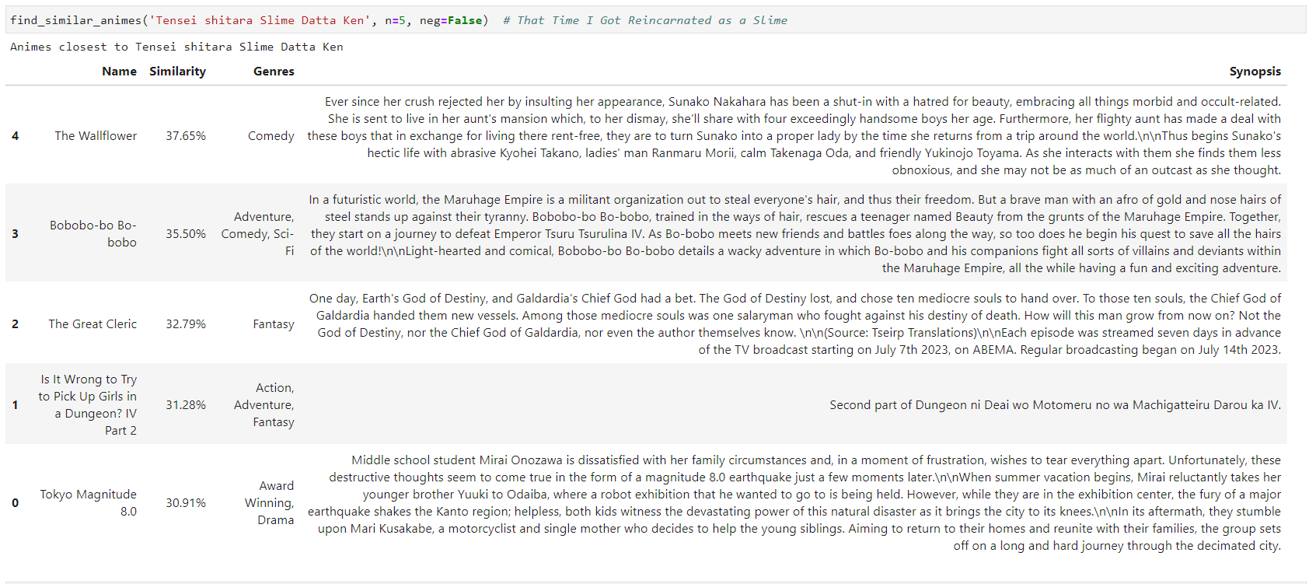

Slide 15
Slide 9: Enhancing User Engagement
Title: Personalized User Recommendations
Precise User Identification
Our system identifies individual users with precision, utilizing unique IDs such as "user_id" to understand their preferences and viewing history.
Leveraging Deep Learning for Similarity
Deep learning techniques power our recommendation engine, calculating user similarity scores based on their interactions with anime content. This is facilitated by utilizing variables like "user_encoder" and "user_weights" to extract and normalize user embeddings.
Tailored User-Specific Suggestions
Recommendations are customized for each user, ensuring that they receive content that aligns with their tastes and preferences. We achieve this by finding similar users, as demonstrated by variables like "similar_users," "random_user," and "ratings_per_user."

Slide 16
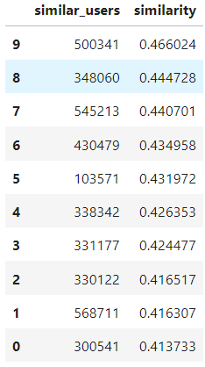
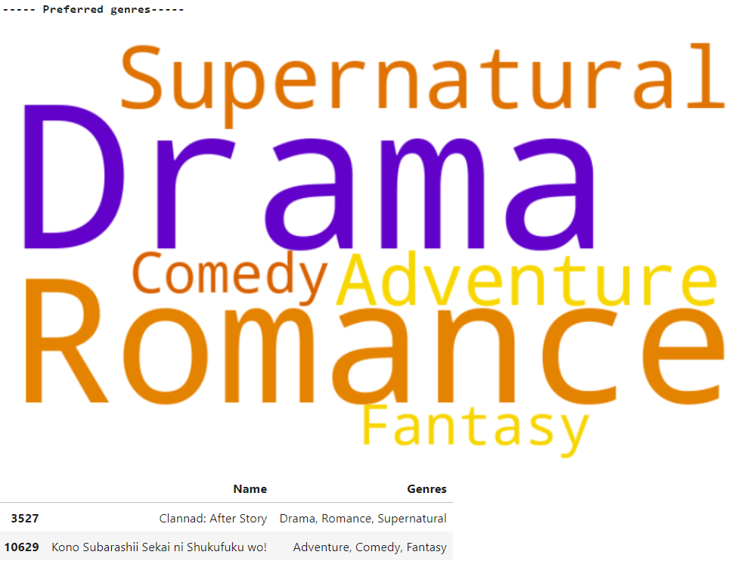

Slide 17
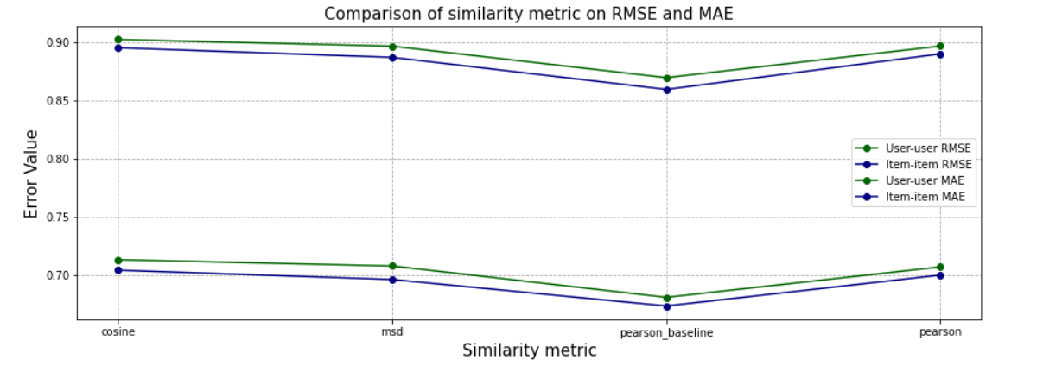
User-User and Item-Based comparison

Slide 18
Model Training (Content-Based Filtering)
Enhancing Personalization with Content-Based Filtering
TF-IDF Vectorizer for Anime Content
To effectively analyze anime content, we employ a TF-IDF (Term Frequency-Inverse Document Frequency) vectorizer. This vectorizer is customized to exclude common English stop words, ensuring that only informative words are considered.
Generating the TF-IDF Matrix
We create a generator that iterates through the 'Genres' column of the anime dataset. This generator efficiently computes TF-IDF values on the fly for each anime genre.
Computing Similarity
The TF-IDF matrix enables us to calculate similarity between anime content. By using the linear_kernel function, we efficiently compute the similarity scores, aiding in the content-based filtering process.
Why TF-IDF?
It helps identify unique and relevant characteristics of each anime, allowing us to make precise and personalized recommendations.
Notes:
Pearson Baseline: This method computes the Pearson correlation coefficient between all pairs of users (or items) using baselines for centering instead of means.

Slide 19
Fine-Tuning Recommendations with Cosine Similarity
Personalized Anime Suggestions
Recommendation Function: get_recommendations
Utilizing cosine similarity, genres, and ratings, our get_recommendations function delivers personalized anime recommendations.
Computing Similarity Scores
When a user selects an anime title, the system calculates similarity scores using cosine similarity on TF-IDF vectors, capturing content relevance.
Filtering and Sorting
Unreliable data is filtered out, ensuring recommendations rely on known ratings. Scores are sorted by both similarity and ratings in descending order.

Slide 20
Evaluation (Part 1)
Model Training and Evaluation
With our data prepared and features selected, we proceed to train and evaluate our recommendation model. Here are the key steps:
Initializing a K-Fold cross-validation with 15 folds for robust evaluation.
Using a Linear Regression model for predicting user ratings.
Iteratively train the model on different folds and evaluate its performance using Mean Squared Error (MSE).
Calculate the average MSE as a measure of how well the model predicts user ratings.
Visualizing Results
To gain insights into our model's performance, we visualize the results in three ways:
A scatter plot of actual vs. predicted values to assess how closely the model predictions align with the true ratings.
A residual plot to visualize the differences between actual and predicted ratings.
A Q-Q Plot (Quantile-Quantile Plot) to check the normality of residuals.
This initial evaluation provides valuable insights into the effectiveness of our recommendation system and guides further refinement and optimization.

Slide 21
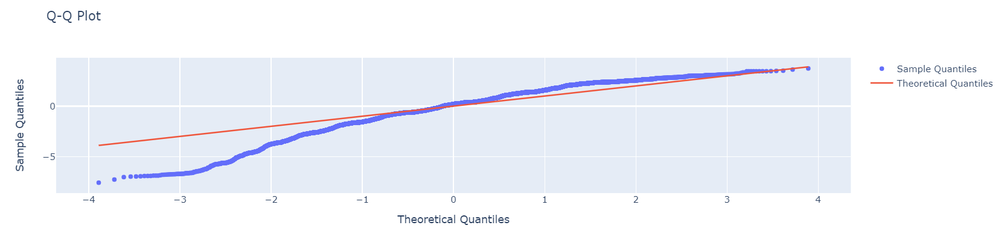
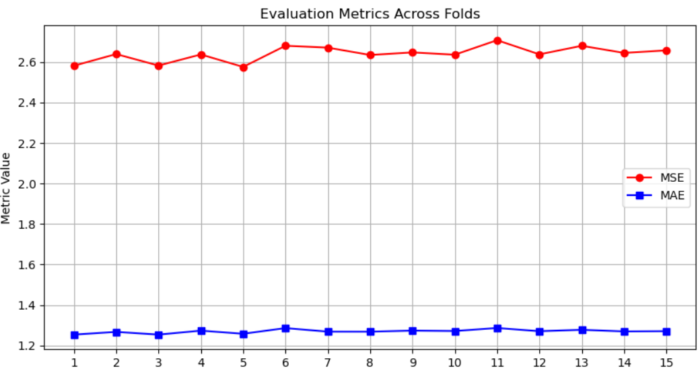

Slide 22
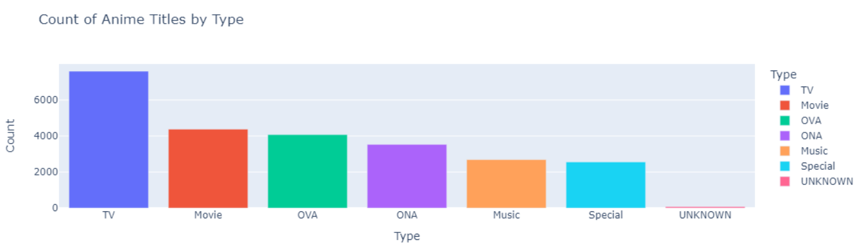
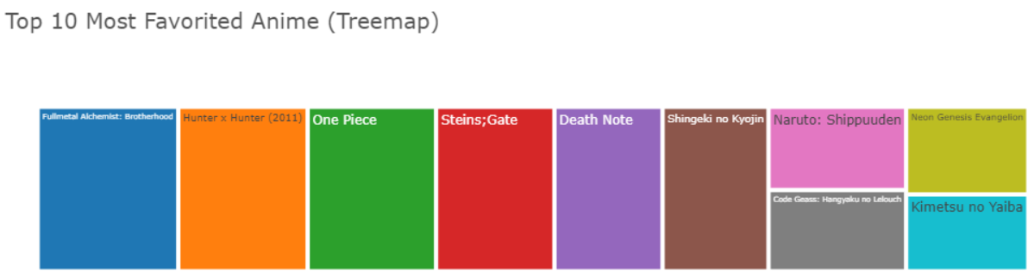
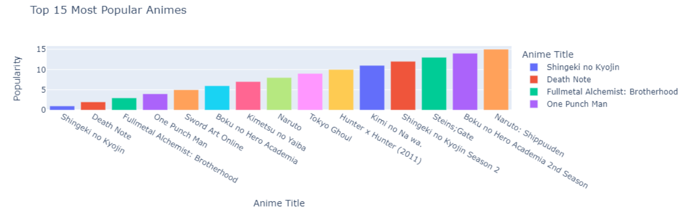
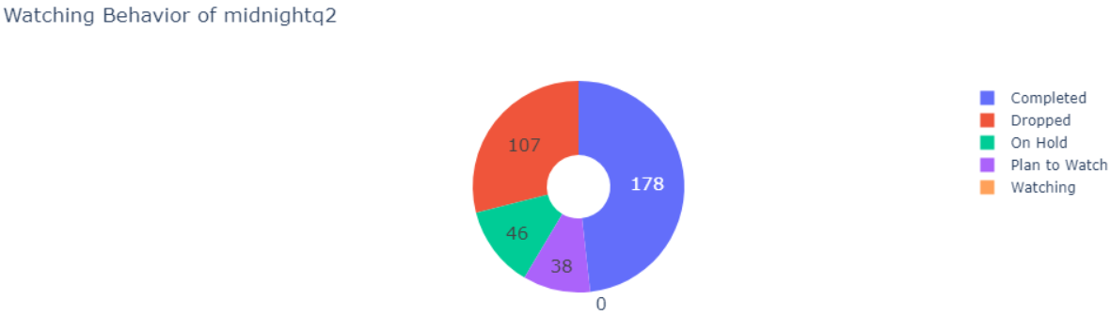
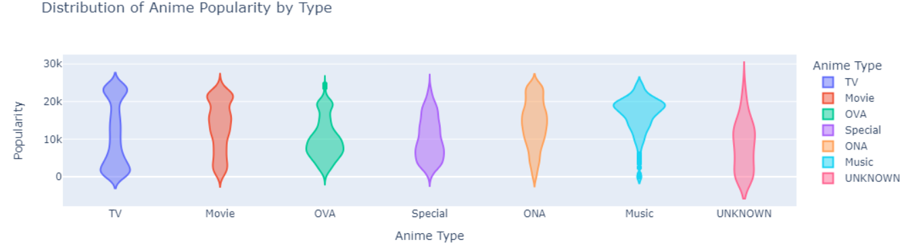
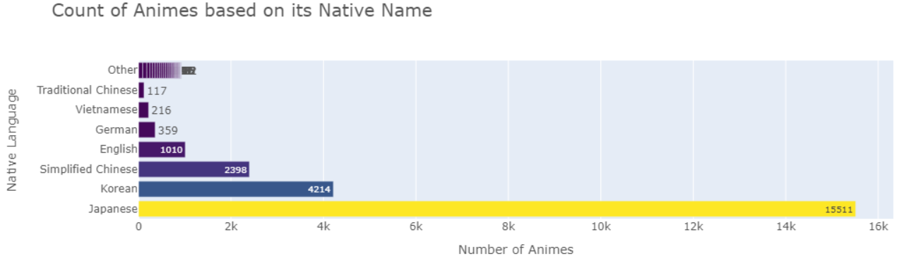

Slide 23
Visualizations
Data Manipulation: We use numpy for numerical operations and pandas for data structure handling.
Data Visualization: Interactive plotting is facilitated by plotly.express, plotly.graph_objects, and plotly.figure_factory, alongside matplotlib.pyplot for static plotting.
Natural Language Processing: The WordCloud library generates word clouds, while langdetect is used for language detection.
Reproducibility: To ensure interactive plots work seamlessly in Jupyter, we initialize the notebook mode with plotly.offline.init_notebook_mode.

Slide 24
Takeaways:
Content based with genre is better for overall similarity between all anime and user datasets.
Anime similarity metric based on features like rating, popularity and number of users watched, genre and etc.
Item-item collaborative filtering works same than user-user collaborative filtering if using a same deep learning model
Combining the predictions and recommendations of different models gives better results aka Content Based in terms of accuracy and quality of recommendations.

Slide 25
References:
Surprise library: https://surprise.readthedocs.io/en/stable/
Hybrid recommendation system: https://arxiv.org/pdf/1901.03888.pdf
Evaluating recommendation system: http://fastml.com/evaluating-recommender-systems/

